Slide 1
LEARNER NEEDS
Learners have different needs.
Can you think of any needs learners have?
KIND OF NEEDS
PERSONAL
LEARNING
PROFESSIONAL
Age
Cultural background
Interests
Educational background
motivation
Learning styles
Past language learning experience
Learning gap
Learning goals
Learner autonomy
Availability of time
Language requirements for employment, training or education

Slide 2
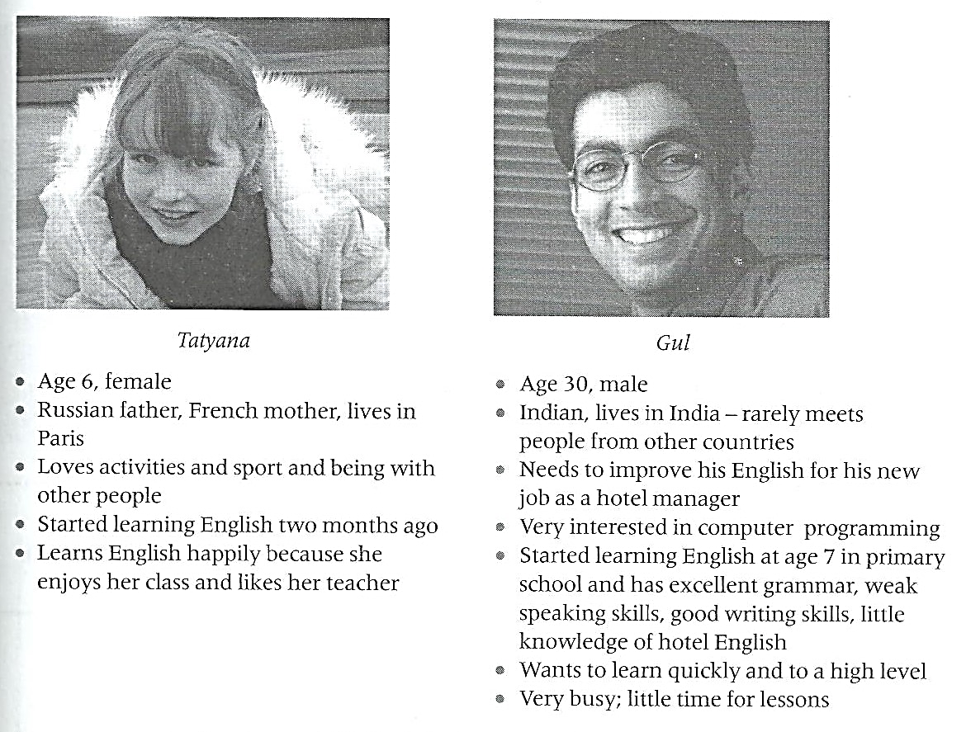
Follow-up activities:
1. Look at these descriptions of two learners. Make notes on their possible learning needs in the English classroom.

Slide 3
2. Here are some teacher’s choices. Which learner needs do they aim to meet?
A- Choosing to read the learners a fairy story.
B- Deciding that three learners should work alone.
C- Choosing to focus on the language of oral presentations with a class of adult professionals.
D- Teaching learners to use a dictionary.
E- Deciding to ask learners why they are learning English and what they hope to achieve with it.
F- Deciding to praise a particular learner.
AGE/ INTEREST
LEARNING STYLE
INTERESTS/ LANGUAGE REQUIREMENTS FOR THE FUTURE
LEARNER AUTONOMY
LEARNING GOALS
MOTIVATION

Slide 4
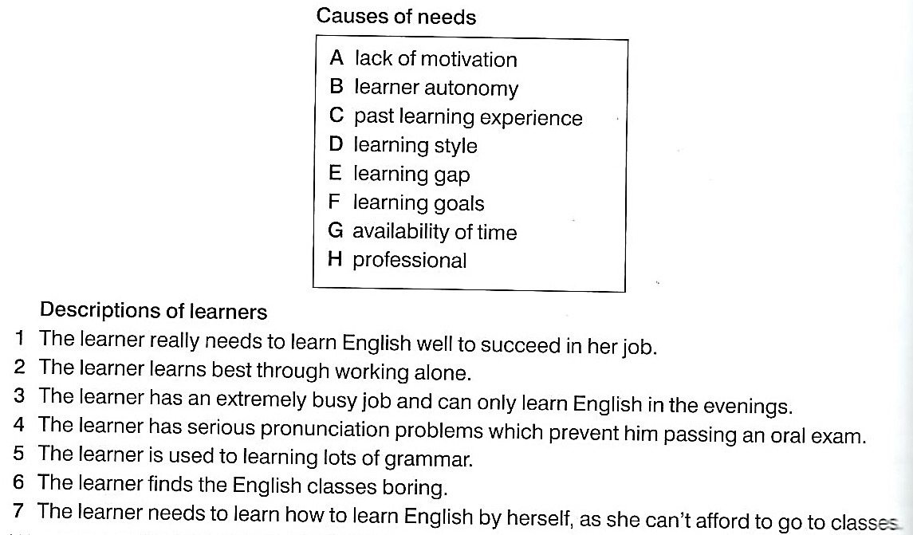
3. For questions 1-7, match the descriptions of the learners with the causes of their needs listed A- H. There is one extra option you do not need to use.
H
D
G
E
C
A
B

Slide 5
4. Match the needs of each group of students with the most suitable type of course. There is an extra option you do not need to use.
B
A
D
F
C
G

Slide 6
DIFFERENCES BETWEEN L1 AND L2 LEARNING
What differences can you think of between L1 and L2 learning?
In groups, think about the learners’ AGE, WAYS OF LEARNING AND CONTEXT that they are learning in.
 | L1 LEARNING | L2 LEARNING
AGE
WAYS OF LEARNING
CONTEXT

Slide 7
Follow-up activities:
1. Look at these two pictures. What differences that influence language learning can you imagine between the two language learning situations?

Slide 8
2. Here are two learners. Which way would you suggest for them to improve their English?
Fatima, aged 10, is Moroccan and speaks Arabic. She lives in the capital, Rabat, with her family. She’s just starting to learn English at school.
A- Go and study in an English- speaking country.
B- Use English when playing with a friend.
C- Do lots of extra homework.
D- Your idea.
Ricardo, aged 40, is Argentinian. He lives in Buenos Aires, with his wife and four children. He has never learned English before but needs it for his new job as a taxi driver.
A- Chat to as many foreign tourists as posible.
B- Study English gramar by himself.
C- Go to conversation classes.
D- Your idea.
What are the advantages and disadvantages of each option?

Slide 9
3. For questions 1-9, match the features of learning with the learners listed A, B or C.
A L1 learner
B L2 beginner classroom learner
C both the L1 and the L2 beginner classroom learner
The features of learning
The learner is very often surrounded by language that is interesting to him/her.
The learner picks up language from the rich language that surrounds him/ her all day.
The learner learns with family and friends.
The learner often hears language that focuses on just one learning point.
The learner uses the language in controlled practice activities.
The learner oftenmakes mistakes.
The learner usually receives lots of individual encouragement.
The learner often stays silent for a long time before finally speaking.
The learner needs time to process new language.
A
A
A
B
B
C
A
A
C

